Slide 1
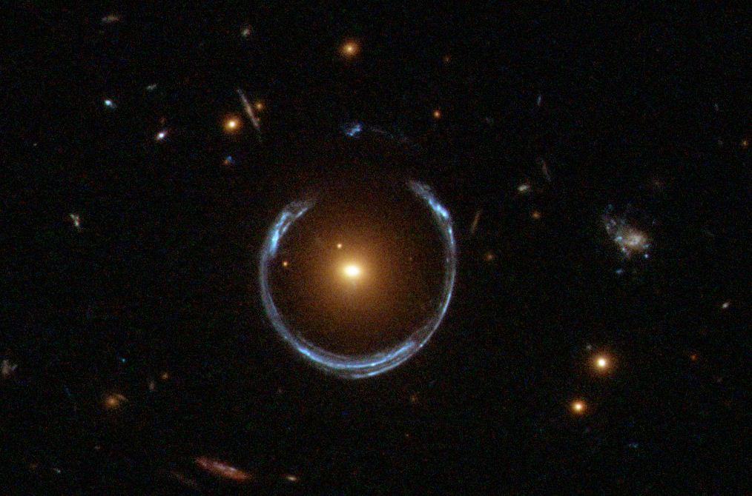
Gravitational Lens
Gravitational Lens

